Slide 1
Document Structure Aware Neural Clinical Concept Recognition
Linlin Li, Mosha Chen, Wei Qiu
Alibaba DAMO Academy

Slide 2
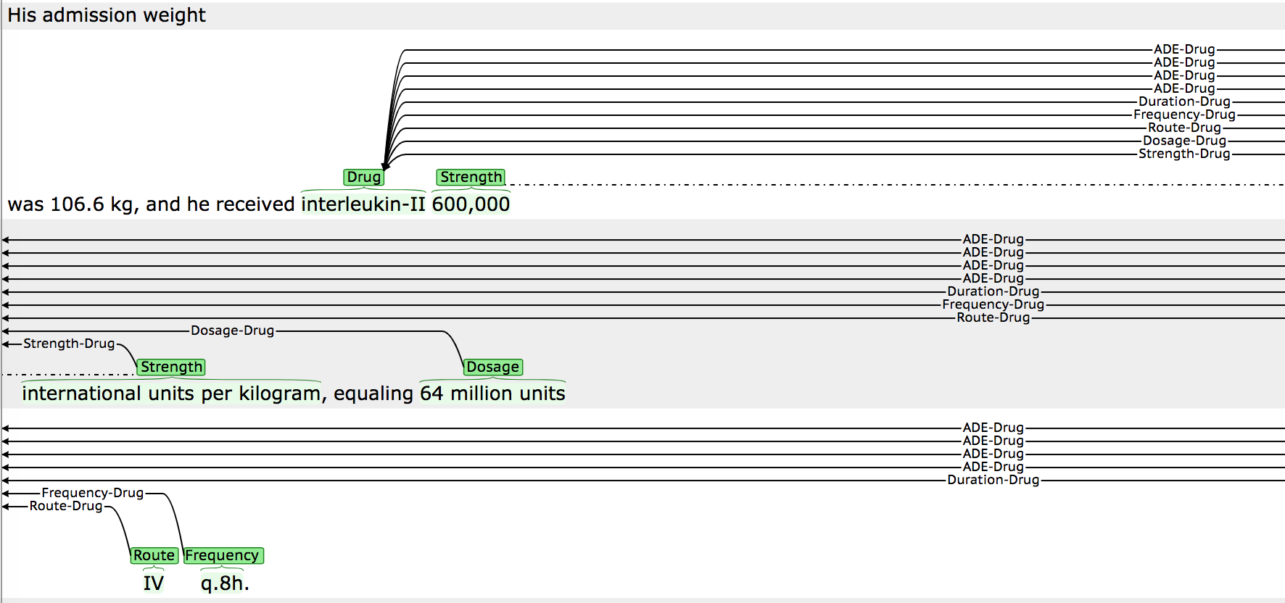
Task description
Identify drug related clinical concepts, e.g., drug, strength, dosage, route, frequency, ADE, reason
Extract the relations between the concepts.

Slide 3
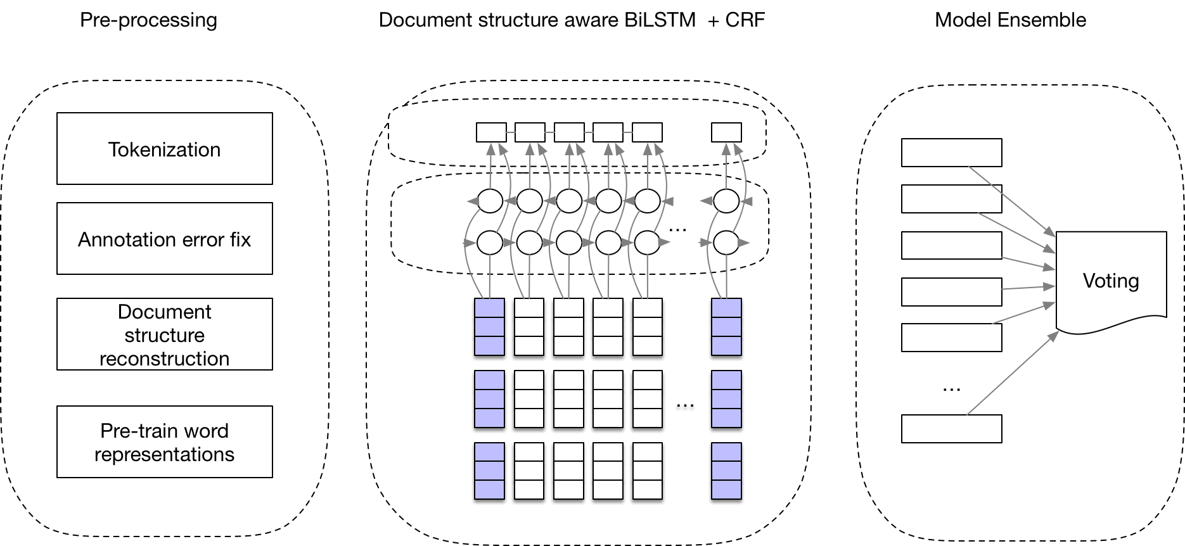
Approach Overview

Slide 4
Preprocessing: Tokenization
Based on spacy: https://spacy.io/
Adding prefix, infix, suffix rules(defined in the form of regular expressions)
Guarantee that the annotated concepts span over at least 1 token.
Examples
10mgQD -> 10mg[dosage] QD[frequency]
5mgQAM -> 5mg QAM
5upRBPs -> 5u pRBPs

Slide 5
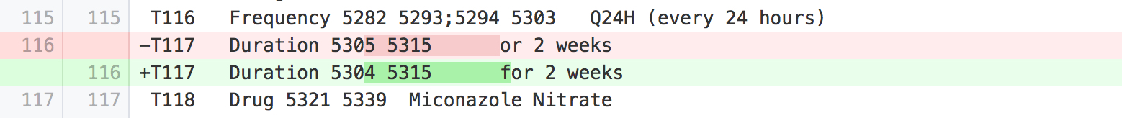
Pre-processing: Data Clean
Annotation fix:
We have manually fixed a few annotation errors(very rare though， 13 items in total)
Eg:

Slide 6
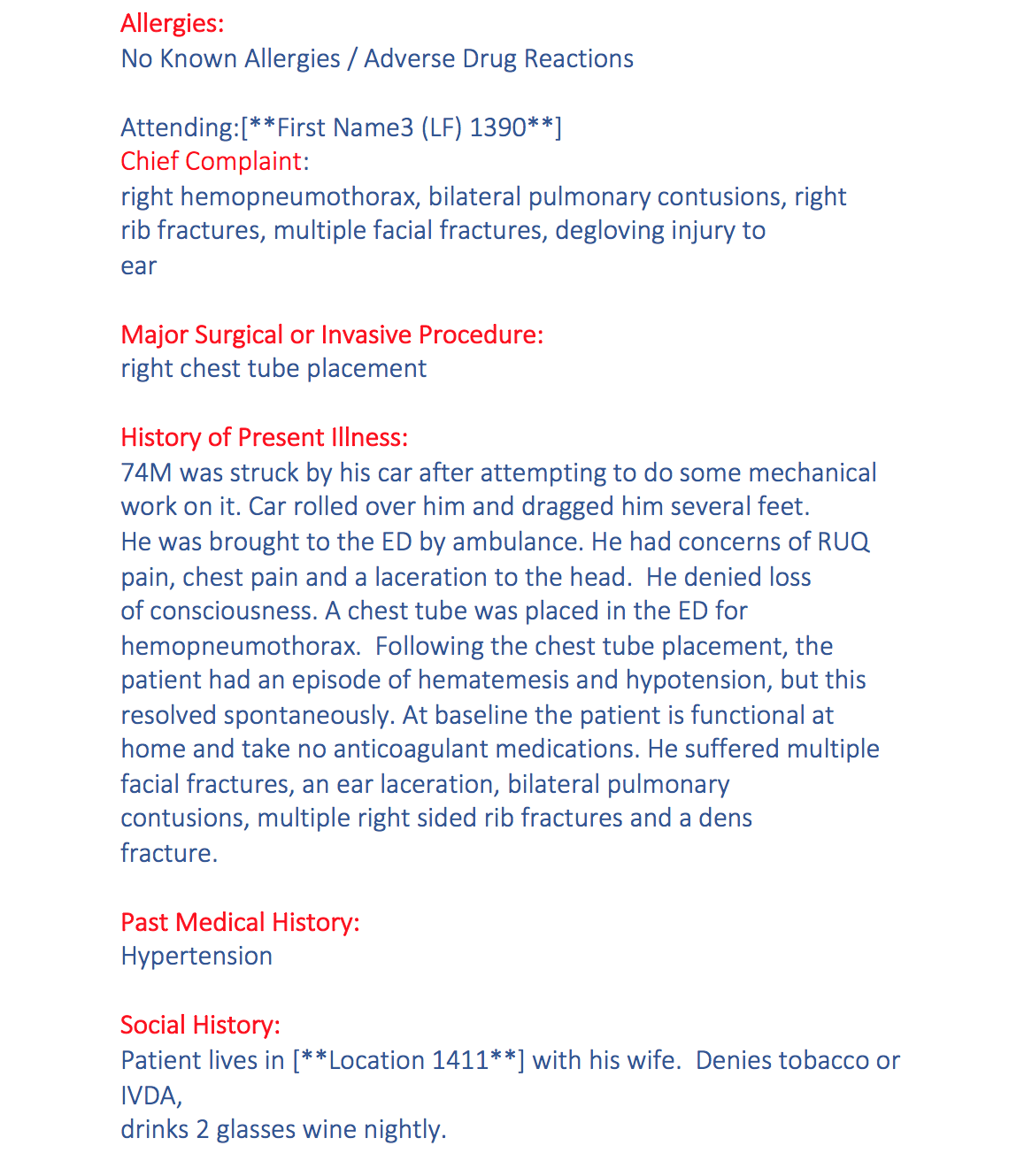
Preprocessing: Section Structure Reconstruction
Motivation:
The clinical concepts do not distribute equally in the different sections of the discharge summaries.
Data Set: Discharge summaries from MIMIC-III Database(59652 records)
Section name selection:
Candidate section names identification using heuristics:
Word_count(line) <= 5 and is_capital(line.first_word) == true
Sort by frequency & select top 50 as potential section names
Manual review and normalization
Eg: ['discharge medications’, 'discharge medication', 'final discharge medications’] -> 'discharge medications’
31 section names in total
Notes:
Q： 如何计算每个句子的 section information
A： 仇伟解释过了

Slide 7
Pre-trained Word Representations
Data Set:
Discharge summaries from Mimic-III Database(59652 records)
Tokenize the discharge summaries
Reconstruct the section information for each line after tokenization.
Word Embedding: Glove (Pennington et al., 2014) , Word2Vec, Fastext:
Use default parameter
Dim: 50, 100, 200, 300
Language Model: Elmo (Perters et al., 2018):
Use default parameter
Notes:
We have tried different embeddings, they generally perform very similar. We found Glove performs slightly better than other options.

Slide 8
Model
Linguistic Features:
PoS tagging using Spacy
Word shape
10mg -> ddxx
5uPRBPs -> dxXXXXx

Slide 9
Utilizing the section information
He had concerns of RUQ pain, chest pain and a
laceration to the head.
Padding the section information:
History of Present Illness He had concerns of RUQ
pain, chest pain and a laceration to the head. History
of Present Illness
or
History of Present Illness He had concerns of RUQ
pain, chest pain and a laceration to the head.
Padded sentences are used for both pre-training
Embedding and training the model

Slide 10
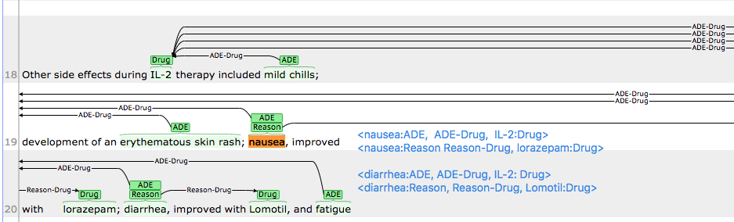
Model: handling overlapped concepts
Overlap Concepts:
Eg:
Stats: 76 overlap cases, most of which are overlaps of ADEs and reasons.
The ADEs and Reasons have the largest number of overlaps
Randomly discard one of the overlapped concepts
Train models that handle the concepts separately, e.g., some models discard ADEs, others discard Reasons. Merge the results of the models.

Slide 11

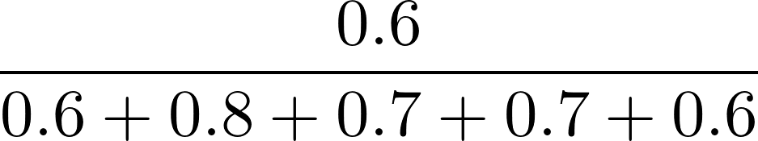
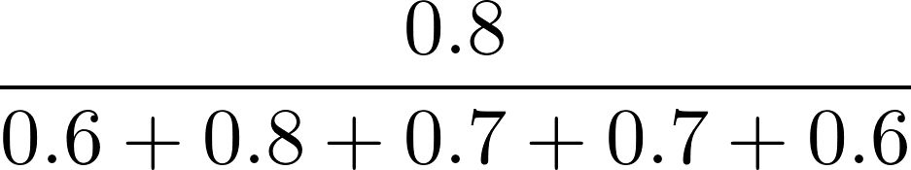
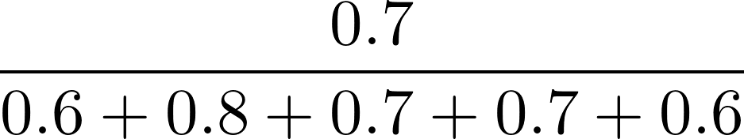
Model Ensemble: Voting
Model | Result | F1(ADE) on test set | Vote
1 | neurotoxicity and 3 doses held due to development of … | 0.6
2 | neurotoxicity and 3 doses held due to development of … | 0.8
3 | neurotoxicity and 3 doses held due to development of… | 0.7
4 | neurotoxicity and 3 doses held due to development of… | 0.7
5 | neurotoxicity and 3 doses held due to development of… | 0.6
Suppose threshold = 0.5, “neurotoxicity”gets total votes 0.6176 > 0.5, then output!

Slide 12
Model Ensemble
Model Ensemble:
We have many models based on different training-set/embeddings/features/...
Data split 1: Training: 251 Validattion:52
Data split 2: Training: 206 Validation:52 Hold-out set: 45 (15%),
Hold-out is used to tune the thresholds for better voting strategy
Voting strategy:
 | Fixed Threshold | Unfixed Threshold
Data split | Data split 1 | Data split 2
Training | Trained on training set, early stop using validation set | Trained on training set, early stop using validation set
Voting weights | Weighted according to F1 on validation set | Weighted according to F1 on hold-out set
Threshold | Fixed to 0.5 | Tuned using hold-out set

Slide 13
Experimental setup
Models: 5 runs for each model using different training/validation split
BiLSTM + CNN + CRF
BiLSTM + CNN + ELMO + CRF
BiLSTM + CNN + ELMO + Section information + CRF
BiLSTM + CNN + ELMO + Section information + Linguistic Features + CRF

Slide 14
Results
Model | Micro Lenient F1 | Lenient F1(Reason) | Lenient F1(ADE)
Base | 0.9285 | 0.6921 | 0.4821
+ Elmo | 0.9332 | 0.6993 | 0.5014
+ Section | 0.9360 | 0.7011 | 0.5270
+ Linguistic features | 0.9355 | 0.7041 | 0.5436
Base model: BilSTM + CNN +CRF
All the number reported are averaged on 5 runs

Slide 15
Results: submissions
Submission 1(Model Ensemble with fixed threshold):
Submission 2(Model Ensemble with unfixed threhold):
Submission 3: Submission 2 + Post-processing rule
If a sentence contains drug and contains “for xxx” phrase, label “for xxx” as reason.
Label all of the tokens which are marked as drugs in training set.
Submission | Micro Lenient F1 | Lenient F1(Reason) | Lenient F1(ADE)
1 | 0.9418 | 0.7281 | 0.5731
2 | 0.9412 | 0.7178 | 0.5279
3 | 0.9410 | 0.7204 | 0.5239

Slide 16
Future work
Efficiently incorporating external knowledge sources:
DrugBank: rich information for drug-name, brand, drug reaction, etc.
Snomed CT
UMLS
…
More powerful models which can handle overlapped concepts
Unified models for both concept and relation extraction

